Slide 1







MINeD HACKATHON 2024
RESUME REVEALER TRACK
Advanced Resume Parsing Challenge
TEAM NAME : CYBER-X
HARIHARAN R
THARUNESHWAR S
KALAISELVI A
ADHIL A
KAMAL M

Slide 2

Problem Statement
Primary Challenge
Standardization Challenge
Skill Extraction Challenge
Develop “ResumeRevealer” to extract detailed information accurately
Standardize job titles and occupations using the O-NET database
Implement advanced feature to mine detailed skills and competencies
Problem Overview
“ResumeRevealer” Track
Diverse resume formats hinder efficient information extraction
Aims to develop a tool for parsing varied resume formats and extracting comprehensive candidate profiles

Slide 3


What is ResumeReveler?
“ResumeRevealer” is an innovative resume parsing system designed to extract detailed information from resumes in various formats, standardize job titles and occupations, and extract skills and competencies to provide a comprehensive candidate profile.

Slide 4








Proposed Model
Resume
Text
Developed with advanced algorithms.
Extract detailed resume information in various formats.
Standardize job titles and occupations.
Extract Skills
Skills
Work
Education
Occupation
Job Title

Slide 5
Standardized Job Titles
Why to Choose US?
Comprehensive Skill Extraction
Flexibility with Multiple Formats
Improved Efficiency in Candidate Evaluation
Accurate Classification of Resume Sections
Seamless O-NET Database Integration

Slide 6
Our Limitations and Scope
Limitations:
Parsing Complex Layouts
Dependency on Input Data Quality
Variability in Skill Extraction
Scope:
Standard Resume Formats
Structured Resumes
Clear Job Titles and Descriptions

Slide 7

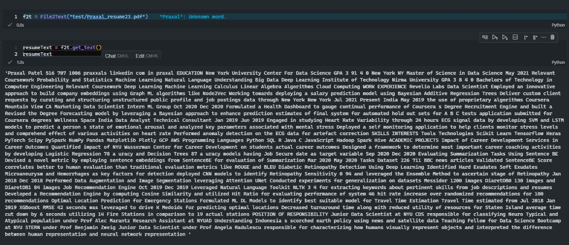
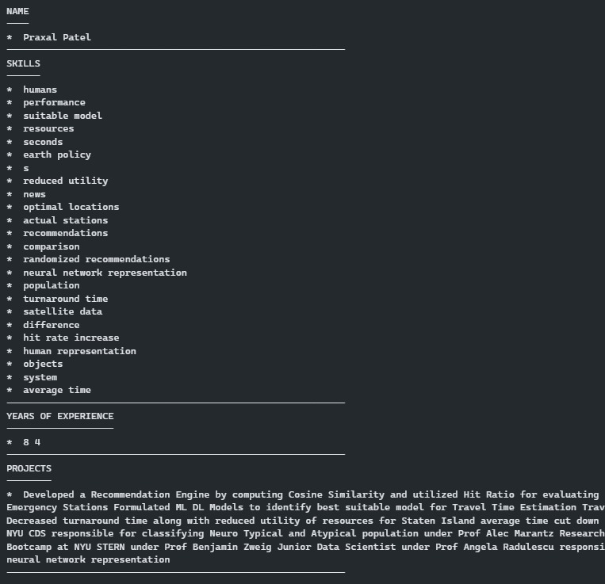
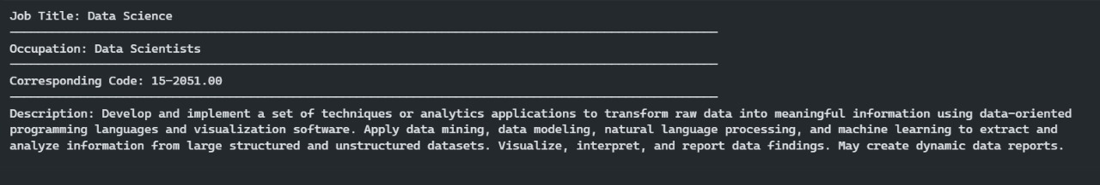
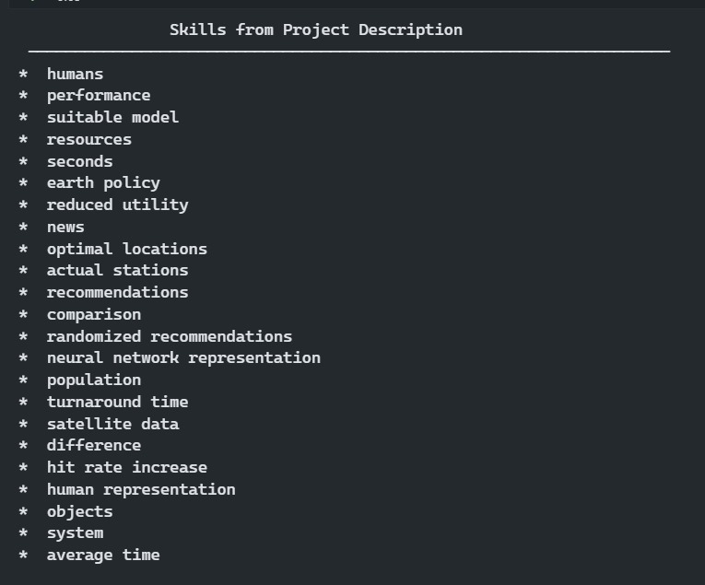
RESUME
EXTRACTED TEXT
TEXT TO PARTITION
PARTITION TO JOB TITLE & OCCUPATION
Abstractive Skill Extraction

Slide 8
Demo Video
https://drive.google.com/file/d/1tHpalRfaPc0mEnF0uUnt6IyofBuejCcg/view?usp=sharing
Reference
https://www.freecodecamp.org/news/how-to-fine-tune-spacy-for-nlp-use-cases/
https://spacy.io/usage/training#training-data
GitHub
https://github.com/HariR1893/CyberX-ResumeRevealer
QUERIES
?

